Slide 1
PCIM Overview

Slide 2
Actors
PCIM Consumer
Interested in knowing device – patient – location – (order ?) associations
PCIM Manager
Maintains master list (database) of associations
PCIM Reporter
Reports an association event to the manager
Reports a disassociation event to the manager

Slide 3
Examples of Actors
PCIM Consumer
Medical device (Ventilator, Infusion Pump, Patient Monitor, Dialysis Machine, …)
Clinical applications that needs this information
PCIM Reporter
EMR
Custom software application (desktop, tablet, phone)
Dedicated hardware device in the room
RTLS system with no user interface
PCIM Manager
EMR
Cloud-based
Dedicated third-party product

Slide 4
Notes
No one vendor will typically implement all three roles in reality
We currently implement all three roles
C++ Library / Gateway is a consumer
Java Platform/Dashboard is a Manager and Reporter
Interoperable, hospital system chooses manager and reporters of their choice based on features, IT capabilities and budget

Slide 5
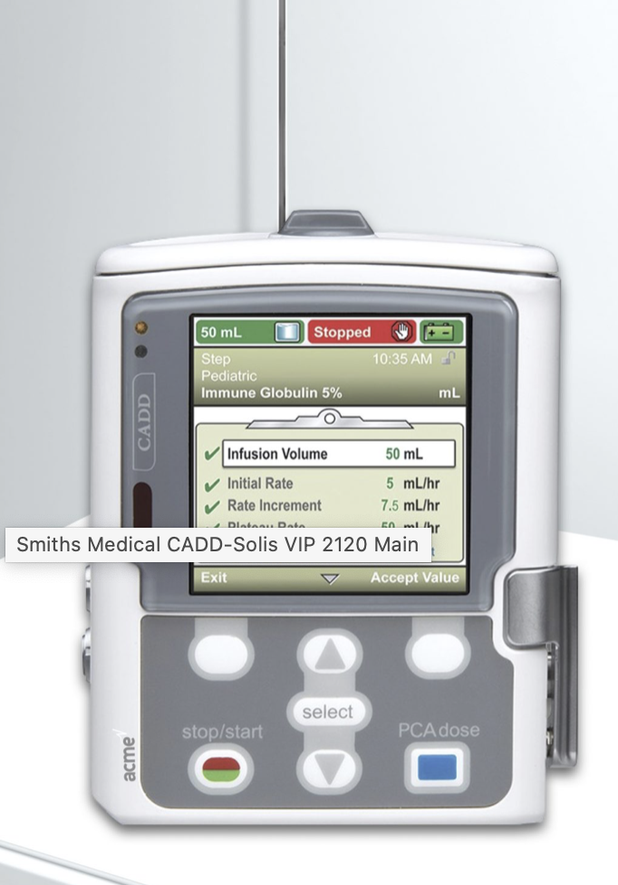
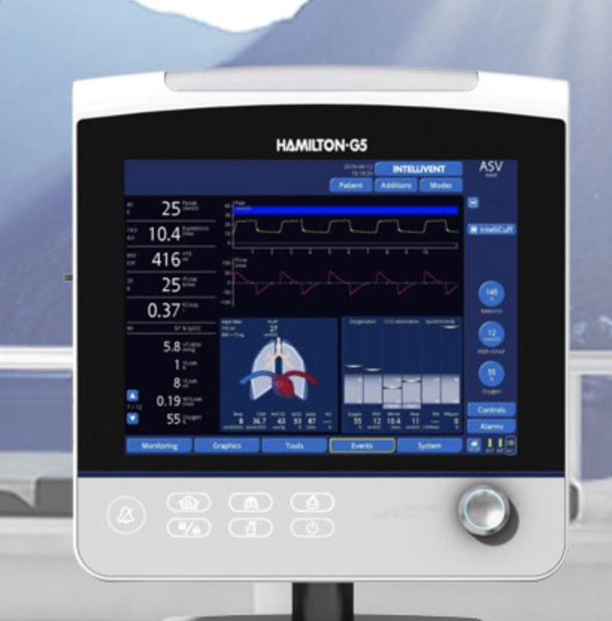
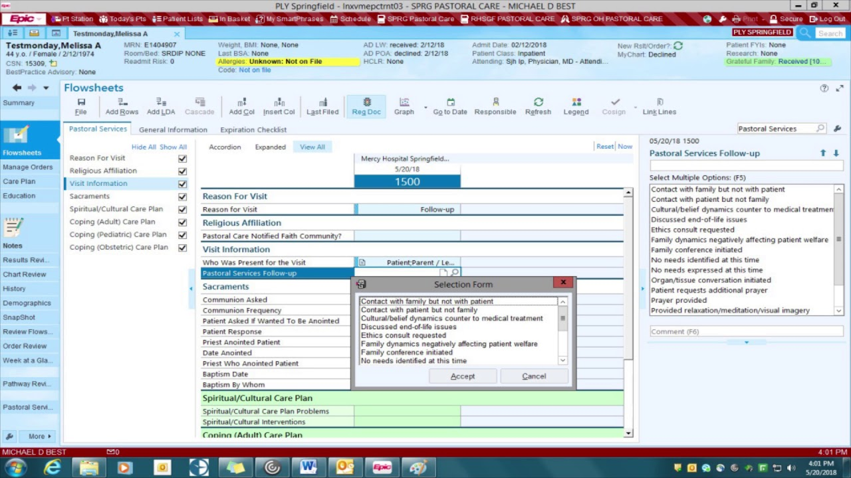

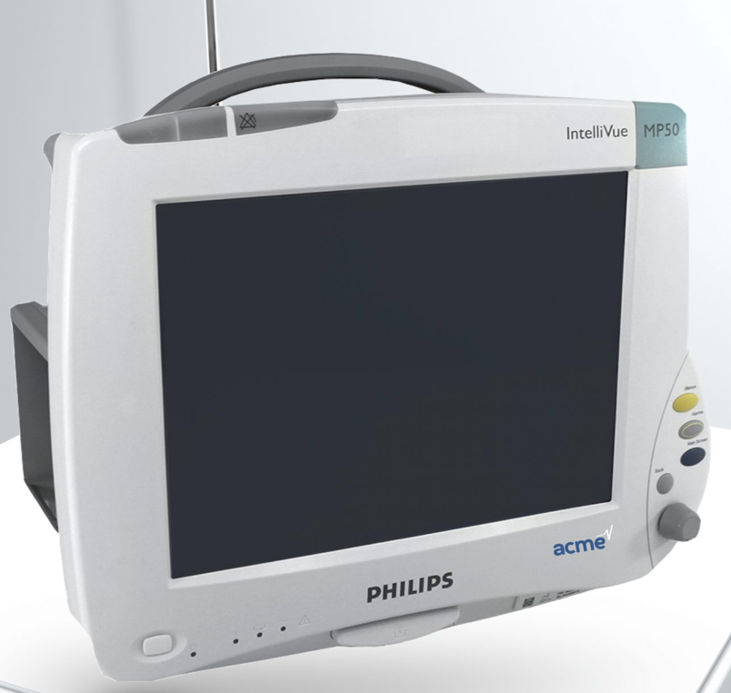
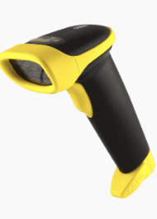
EMR scanner
Pump
Vent
EMR with Scanner
Bed
Monitor
PCIM Manager / Reporter
PCIM Consumers (IML)

Slide 6
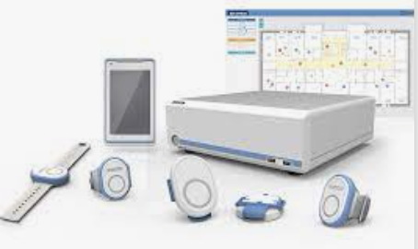
EMR scanner with RTLS
Pump
Vent
EMR with Scanner
Bed
PCIM Manager / Reporter / Consumer
Monitor
RTLS system
PCIM Consumers (IML)
PCIM Reporter

Slide 7
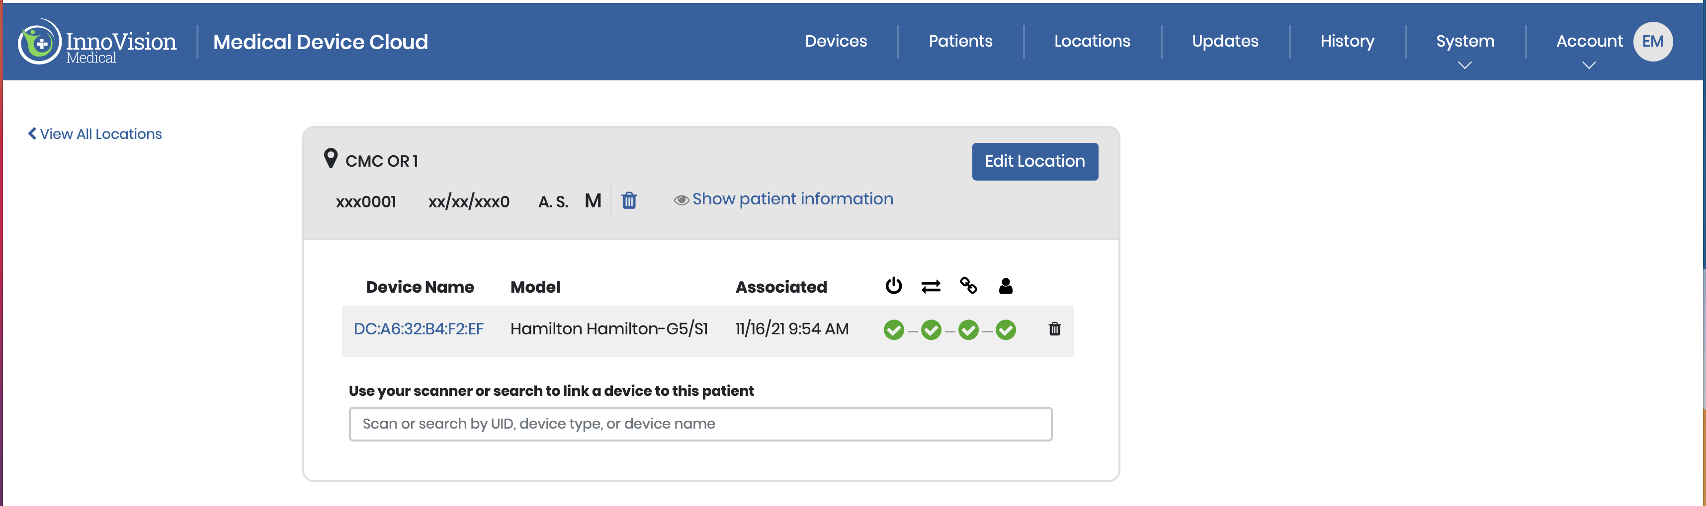
Cloud-based, scanner with RTLS
Pump
Vent
App with Scanner
Bed
PCIM Manager / Reporter
Monitor
RTLS system
PCIM Consumers (IML)
PCIM Reporter

